Slide 1
Project Plan
J. Belmonte

Slide 2

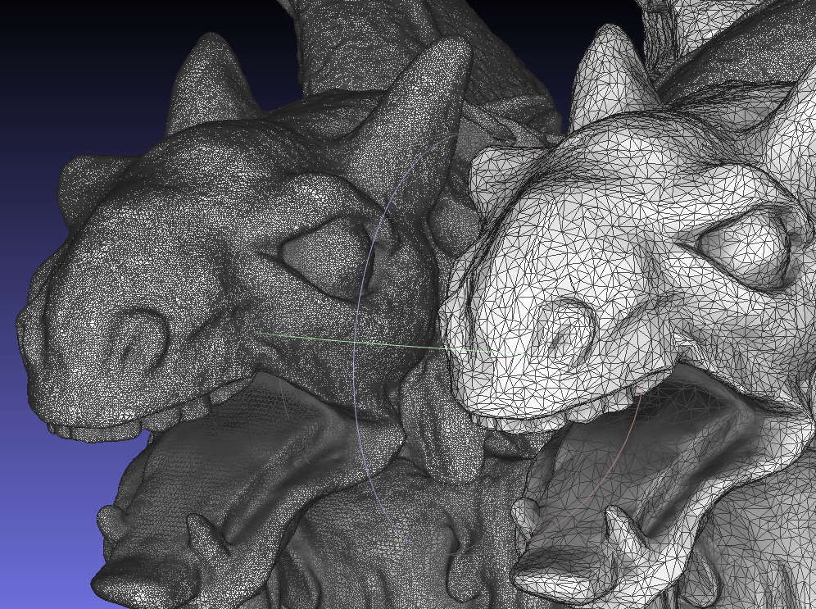
Investigate optimisation techniques for OpenGL performance
3D graphics and rendering
Machine Learning & Deep Learning Computations
Graphics Pipeline
Evaluate properties of GPU and bottlenecks

Slide 3
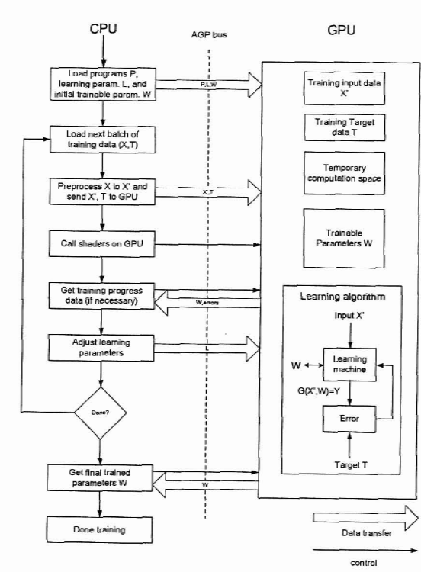
Focus Points
Evaluation of OpenGL optimisation techniques
Investigate cross-optimisation with ML and Deep Learning computation and assess bottlenecks
Deploying solution
ML JS Library integration with TensorFlow.js
CUDA X
ML Algorithm Flow diagram by Steinkraus et al. [3]

Slide 4
Overview: Year 2 Gantt Chart – Semester 1
 | Targets | W1 | W2 | W3 | W4 | W5 | W6 | W7 | W8 | W9 | W10 | W11 | W12
 | Evaluation
 | General OpenGL optimisations
 | GPU Computing for Machine Learning
 | Primary Solution
 | Develop ML Library for JS with WebGPU
 | Secondary Solution
 | CUDA X
 | Complimentary solution
 | Integration / Development on TensorFlow.js

Slide 5


Milestones for SEM1
Assessment of OpenGL for ML and Deep Learning
Solutions to GPU Bottlenecks
Knowledge of GPGPU:
TensorFlow.js [5]
Parallel Programming [6]
CUDA C programming [7]
WebGPU [8]
Machine Learning & Deep Learning Computation [9]
Evaluation of proposed solutions
Development of JS ML library
Integration of CUDA X Libraries
Integration with TensorFlow.js
Benchmarking technologies
[4] CUDA by Nivida Group
[5] TF.js by Google Brain Team

Slide 6
Overview: Year 2 Gantt Chart – Semester 2
 | Targets | W1 | W2 | W3 | W4 | W5 | W6 | W7 | W8 | W9 | W10 | W11 | W12
 | Implementation
 | Primary Solution
 | Develop JS ML Library with Integration with TensorFlow.js
 | Secondary Solution
 | CUDA X Library Integration
 | Quantiative Evaluation
 | Comparison of ML/DL Libraries
 | Assesment of Optimisation technqiues
 | Benchmark Technologies

Slide 7







Milestones for SEM2
Deploy
Evaluate
Report

Slide 8
Summary
Project Goals:
Evaluation of OpenGL performance techniques on ML & DL processes
Quantitative comparison on Web based ML solutions to Dedicated GPGPU Libraries
Future of Web Based ML solutions, Client/Server-Side computation
Key Technologies
Main:
WebGPU, Node.js, TensorFlow.js
CUDA X
Benchmarking:
PerfTools or TraceGL
Nsight Systems/Compute
Complimentary:
WebAssembly
Emscripten

Slide 9
References
[1]Shutterstock, “Stock Photos, Pictures & Royalty Free Videos | Shutterstock,” Shutterstock, 2023. https://www.shutterstock.com/
‌[2]Meshlab.net, 2024. https://www.meshlab.net/img/Feature/Simplification.jpg (accessed Nov. 20, 2024).
‌[3] D. Steinkraus, I. Buck, and P. Y. Simard, “Using GPUs for machine learning algorithms,” Eighth International Conference on Document Analysis and Recognition (ICDAR’05), 2005, doi: https://doi.org/10.1109/icdar.2005.251.
‌[4]NVIDIA, “CUDA Toolkit,” NVIDIA Developer, Jul. 02, 2013. https://developer.nvidia.com/cuda-toolkit
‌[5] “TensorFlow.js,” TensorFlow, 2019. https://www.tensorflow.org/js
[6] B. Schmidt, J. Gonzalez-Dominguez, C. Hundt, and M. Schlarb, Parallel Programming. Morgan Kaufmann, 2017.
[7] J. Cheng, M. Grossman, T. Mckercher, and B. Chapman, Professional CUDA C programming.
[8]“WebGPU API - Web APIs | MDN,” developer.mozilla.org. https://developer.mozilla.org/en-US/docs/Web/API/WebGPU_API Indianapolis, Indiana: Wrox, 2014.
‌[9] Andrew Ng, Machine Learning Yearning, Draft. deeplearning.ai, 2018
‌[10] “NVIDIA CUDA-X,” NVIDIA Developer, Oct. 06, 2011. https://developer.nvidia.com/gpu-accelerated-libraries
[11] “OpenCL - The Open Standard for Parallel Programming of Heterogeneous Systems,” The Khronos Group, Jul. 21, 2013. https://www.khronos.org/opencl/
https://www.meshlab.net/

